Slide 1
INTRODUCTION TO CLOUD COMPUTING
Bachelor of Engineering- Computer Science & Engineering
Cloud Computing (CC)(23CS009)
Department of Computer Science & Engineering
Chitkara University Institute of Engineering and Technology, Chitkara University, Punjab, India

Slide 2
INTRODUCTION TO CLOUD COMPUTING
Cloud computing allows users to access computing services (like servers, storage, databases, networking, and software) over the internet instead of using local servers or personal devices.
It enables faster innovation, flexible resources, and economies of scale.
Example: Google Drive, AWS, Microsoft Azure.
Cloud computing is the delivery of computing services over the internet (“The Cloud”) to offer faster innovation, flexible resources, and economies of scale. Instead of purchasing, owning, and maintaining physical data centers and servers, users can access computing power, storage, and applications from cloud service providers on a pay-as-you-go basis.
Key Concepts in Cloud Computing
Virtualization – Creating a virtual version of servers, storage, or networks.
Multi-tenancy – Serving multiple users (tenants) with the same physical resources.
Elasticity – Scaling resources up or down based on demand.
Pay-per-use – Users pay only for what they use (like electricity or water).
Self-service – Users can provision resources without human intervention.

Slide 3
History & Evolution of Cloud Computing
Cloud computing didn’t appear overnight. Its evolution is rooted in decades of progress in computing and networking. Let’s look at key milestones across decades:
1960s – The Conceptual Foundations This was the beginning of time-sharing systems. John McCarthy, a renowned computer scientist, proposed the idea that "computation may someday be organized as a public utility. "Mainframe computers were used by multiple users through terminals, a concept similar to modern multi-tenant cloud systems. Virtualization—creating virtual versions of hardware—was first explored here (IBM pioneered early virtual machines).Analogy: Like different people using one giant computer at the same time.
1990s – Rise of the Internet & Web Services With the expansion of the Internet, it became feasible to deliver computing resources over a network. Companies started offering Application Service Providers (ASPs)—basic hosted software over the internet.This period laid the foundation for web-based applications, e.g., Hotmail, Yahoo Mail. Concepts like grid computing and distributed systems began gaining traction. Importance: Made remote access to software and data possible.
2006 – Launch of Amazon Web Services (AWS)Amazon launched AWS EC2 and S3, offering on-demand compute and storage services. This marked the birth of modern cloud computing as a commercial service. For the first time, startups and developers could rent infrastructure instead of buying it, dramatically reducing IT costs. AWS’s pay-as-you-go model became the standard. Impact: Democratized access to powerful computing resources.

Slide 4
History & Evolution of Cloud Computing
2010s – Entry of Major Cloud Players Google Cloud Platform (GCP), Microsoft Azure, IBM Cloud, Oracle Cloud, and Alibaba Cloud entered the market. Cloud matured to support SaaS, PaaS, and IaaS models. Adoption spread across industries: education, healthcare, finance, e-commerce. Enterprises began migrating entire infrastructures to the cloud. Hybrid cloud and multi-cloud strategies emerged. Significance: Cloud became an enterprise-grade solution.
2020s and Beyond – Intelligent Cloud Era The focus shifted toward Edge Computing – processing data closer to where it’s generated. Integration of Artificial Intelligence (AI), Machine Learning (ML), and Big Data into cloud platforms. Rise of serverless computing and containers (e.g., Kubernetes, AWS Lambda).Enhanced focus on cloud security, compliance, and sustainability (green cloud).Cloud is now foundational for technologies like IoT, blockchain, and autonomous systems. Trend: From centralized cloud to smart, distributed, and intelligent cloud ecosystems.

Slide 5
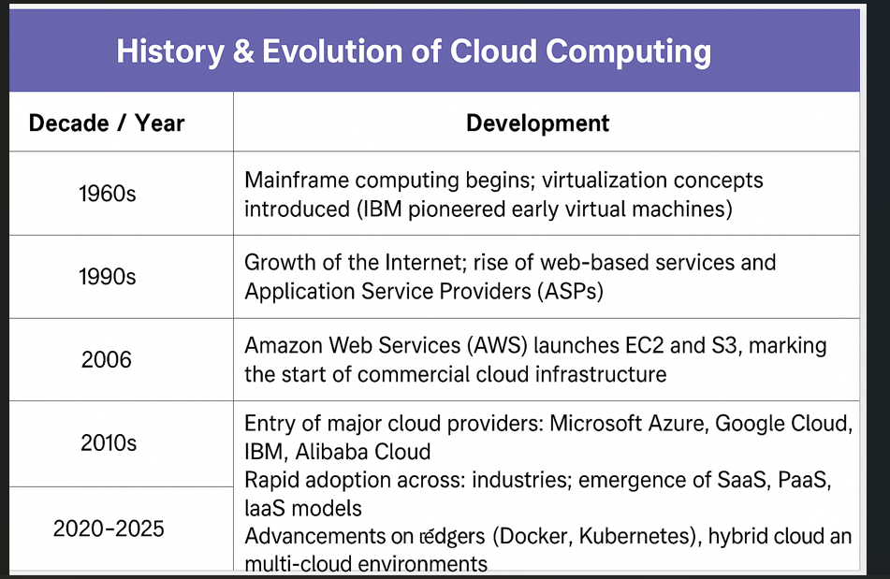
History & Evolution of Cloud Computing

Slide 6
Characteristics of Cloud Computing
There are many characteristics of Cloud Computing here are few of them :
On-demand self-services: The Cloud computing services does not require any human administrators, user themselves are able to provision, monitor and manage computing resources as needed.
Broad network access: The Computing services are generally provided over standard networks and heterogeneous devices.
Rapid elasticity: The Computing services should have IT resources that are able to scale out and in quickly and on as needed basis. Whenever the user require services, it is provided and scale out as soon as its requirement gets over.
Resource pooling: The IT resource (e.g., networks, servers, storage, applications, and services) present are shared across multiple applications and occupant in an uncommitted manner. Multiple clients are provided service from a same physical resource.
Measured service: The resource utilization is tracked for each application and occupant; it will provide both the user and the resource provider with an account of what has been used. This is done for various reasons like monitoring billing and effective use of resource.

Slide 7
Characteristics of Cloud Computing
Multi-tenancy: Cloud computing providers can support multiple tenants (users or organizations) on a single set of shared resources.
Virtualization: Cloud computing providers use virtualization technology to abstract underlying hardware resources and present them as logical resources to users.
Resilient computing: Cloud computing services are typically designed with redundancy and fault tolerance in mind, which ensures high availability and reliability.
Flexible pricing models: Cloud providers offer a variety of pricing models, including pay-per-use, subscription-based, and spot pricing, allowing users to choose the option that best suits their needs.
Security: Cloud providers invest heavily in security measures to protect their users’ data and ensure the privacy of sensitive information.
Automation: Cloud computing services are often highly automated, allowing users to deploy and manage resources with minimal manual intervention.
Sustainability: Cloud providers are increasingly focused on sustainable practices, such as energy-efficient data centers and the use of renewable energy sources, to reduce their environmental impact.

Slide 8
Need for Cloud Computing
1. Cost Efficiency:
Cloud computing moves expenses from capital expenditure (buying and maintaining hardware) to operational expenditure (paying for what you use).
It eliminates the need to invest in expensive hardware, software, and IT personnel to manage on-premises infrastructure.
Businesses can scale resources up or down based on demand, optimizing costs and avoiding over-provisioning.
2. Scalability and Flexibility:
Cloud computing allows businesses to easily scale their resources up or down based on fluctuating demands.
This flexibility is crucial for handling seasonal spikes, unexpected growth, or new project deployments.
Organizations can quickly provision new resources as needed, without the delays associated with traditional IT infrastructure.
3. Enhanced Collaboration:
Cloud-based platforms facilitate seamless collaboration among teams, regardless of their location.
Shared access to documents, applications, and data enables teams to work together more efficiently.
This improved collaboration leads to faster decision-making and increased productivity.

Slide 9
Need for Cloud Computing
4. Faster Innovation:
Cloud providers offer access to cutting-edge technologies like AI, machine learning, and big data analytics.
Businesses can leverage these tools to develop new products and services, improve customer experiences, and gain a competitive edge.
The cloud enables faster development cycles and quicker time to market for new solutions.
5. Business Continuity and Disaster Recovery:
Cloud providers offer robust disaster recovery solutions, ensuring business continuity in the event of unexpected outages.
Data backups and redundancy mechanisms protect against data loss and minimize downtime.
This ensures that businesses can continue operating even during unforeseen circumstances.
6. Accessibility and Mobility:
Cloud computing allows users to access their data and applications from anywhere with an internet connection.
This enables remote work and improves workforce flexibility, allowing employees to stay productive while working from different locations.
It also facilitates access to critical information for sales teams on the go and other mobile users.

Slide 10
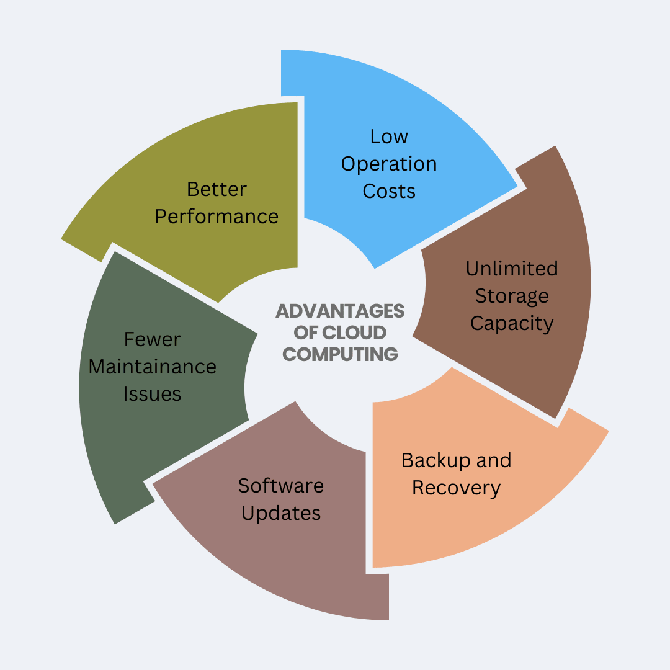
Advantages of cloud computing

Slide 11
Advantages of cloud computing
1. Low Operation Costs Cloud eliminates the need for purchasing expensive hardware and infrastructure. You only pay for the services/resources you use (pay-as-you-go model).Reduces costs related to maintenance, upgrades, and staffing.
2. Unlimited Storage Capacity Cloud platforms offer scalable storage options—storage can grow with your data needs. Users can store massive volumes of data (text, images, videos, backups, etc.) without worrying about physical limits.
3.Backup and Recovery Automatic and reliable data backups are a key feature. Cloud ensures fast disaster recovery in case of data loss, hardware failure, or cyber attacks. Many providers offer geo-redundancy (backups stored in multiple locations).
4. Software Updates The cloud provider handles automatic software and security updates. Users always get the latest features and security patches without manual intervention.
5. Fewer Maintenance Issues Since infrastructure is managed by the provider, users face fewer hardware/software problems. Reduced burden on internal IT teams.
6. Better Performance Cloud data centers are optimized for speed, reliability, and availability. They often use high-performance computing and global networks to ensure consistent service.

Slide 12
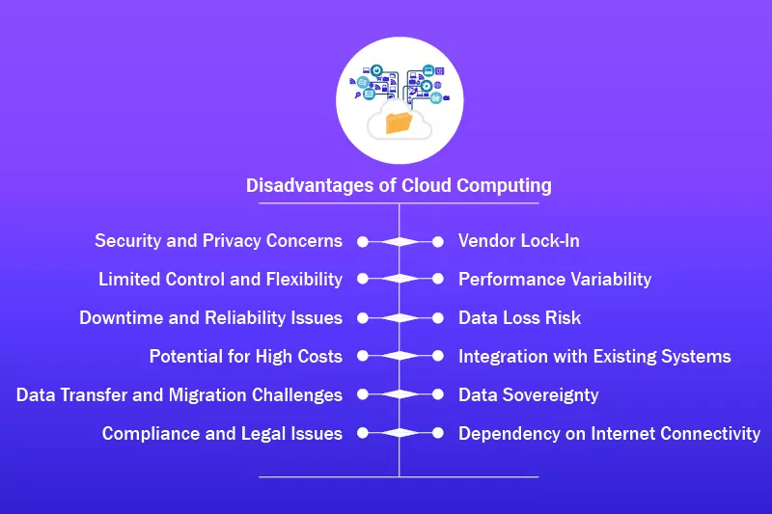
Disadvantages of Cloud Computing

Slide 13
Disadvantages of Cloud Computing
1. Security and Privacy Concerns
Storing sensitive data on third-party servers can lead to unauthorized access, data breaches, or loss of confidentiality.
Compliance with privacy laws like GDPR becomes crucial.
2. Vendor Lock-In
Once committed to a cloud provider (e.g., AWS, Azure), migrating to another provider can be technically and financially challenging.
3. Limited Control and Flexibility
Customers have limited control over infrastructure as it’s managed by the provider.
Customization may be restricted.
4. Performance Variability
Shared cloud resources can cause variable performance, especially during peak usage times.
Network latency or downtime from the provider's end can affect service quality.
5. Downtime and Reliability Issues
Cloud services may experience outages (e.g., AWS, Google Cloud outages).
Businesses can be affected if there is no backup plan.
6. Data Loss Risk
Despite backups, data may still be lost due to accidental deletion, malicious attacks, or provider failure.

Slide 14
Disadvantages of Cloud Computing
7. Potential for High Costs While cloud seems cost-effective, poor resource management (e.g., forgetting to turn off unused instances) can lead to unexpected bills.
8. Integration with Existing Systems Migrating legacy applications or data may not be straightforward and might require reconfiguration or redesign.
9. Data Transfer and Migration Challenges Moving large volumes of data to/from the cloud can be time-consuming, expensive, and may involve data compatibility issues.
10. Data Sovereignty Data stored in foreign data centers may be subject to the laws of that country, creating compliance challenges.
11. Compliance and Legal Issues Cloud providers and users must ensure compliance with industry-specific laws like HIPAA, PCI-DSS, etc. Legal responsibilities may be unclear in case of data breaches.
12. Dependency on Internet Connectivity Without a stable internet connection, cloud services become inaccessible, affecting business operations and continuity.

Slide 15


